Slide 1

GHCI CODEATHON 2020
Presented by : codeblack
Team Member : PALAK SOMANI
NAMITA MAHESHWARI
GUNJAN AGARWAL

Slide 2

EDGILE :
A Virtual Classroom Platform...
Learn what you need,
when you need,
where you need !!!

Slide 3
PROBLEM STATEMENT
DESIGN AND DEVELOP AN ONLINE CLASSROOM THAT ALLOWS PARTICIPANTS TO DO VARIOUS JOBS,
i.e. Virtual Classroom (EDGILE).

Slide 4
PROPOSED SOLUTION
➢ Edgile can be used to hold the classes by watching videos. More than one student can clear their doubts by messaging their teachers.
➢ It allows instructors to deliver web based training to geographically dispersed student, employees and customers .
➢ Each subject includes a synchronous lesson exercise for students .
➢ Besides being user friendly, Edgile virtual classroom have built in collaboration tools that engage the students in active learning.
➢ It can also be used to hold live classroom discussion via video-calling feature.

Slide 5
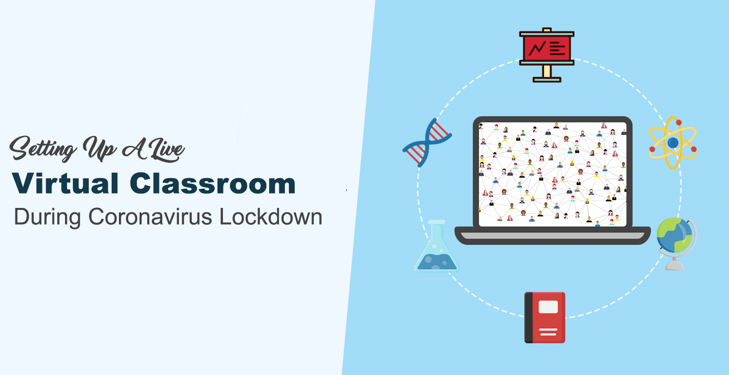

Slide 6
WHAT IS VIRTUAL CLASSROOM ?
Virtual Classroom is going to be used by the existing organizations as well as educational institutes that exists in reality and are trying to make their way of learning more strong and interesting for an employee and the student respectively.
This also utilises advanced techniques like video-lectures and query posting forums along with the communication medium that bridges the gap between student/employee and teacher out of the class or organization and provides more flexibility to naïve users.
It also provides a medium to evaluate the learner’s knowledge of a particular course by making them appear for the examination at the end of that course.

Slide 7
When students improve their attendance rates, they improve their academic prospects and chances of graduating.

Slide 8
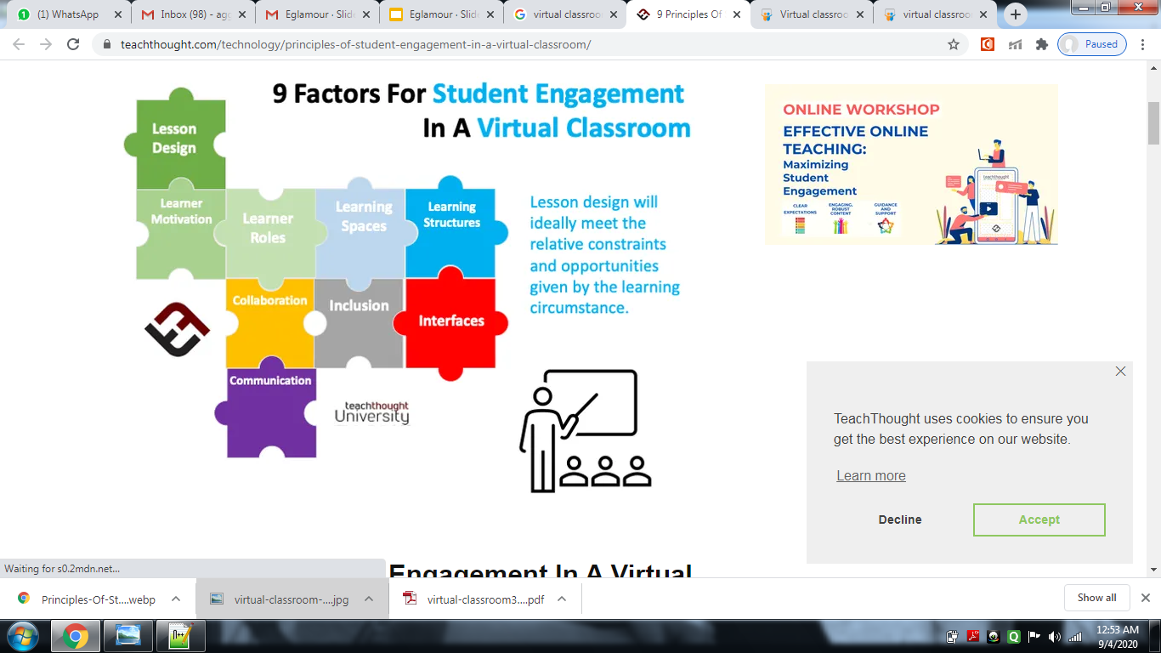

Slide 9
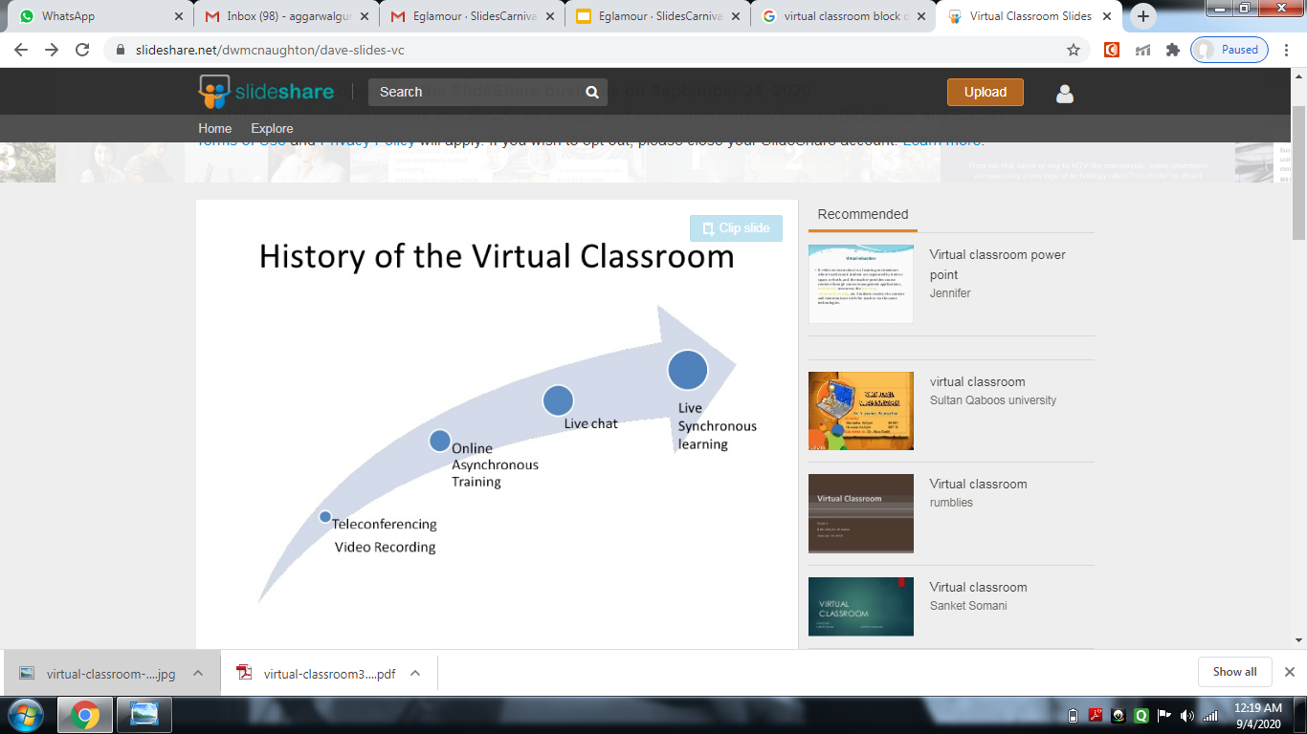
HISTORY OF VIRTUAL CLASSROOM

Slide 10
AIMS AND OBJECTIVE
To develop a Edgile tool for synchronous distance learning with multimedia facilities.
Aims to bring learners from around the world together online in highly interactive manner by greatly reducing travel, time and expenses of on site training.
To provide similar facilities to learners as in traditional classroom by implementing components such as chat room, quizes, web cam etc.

Slide 11
KEY COMPONENTS
➢ Non-Restricting
➢ Affordable
➢ Flexible Learning
➢ Practical and Proven
➢ Easy Accessibility

Slide 12
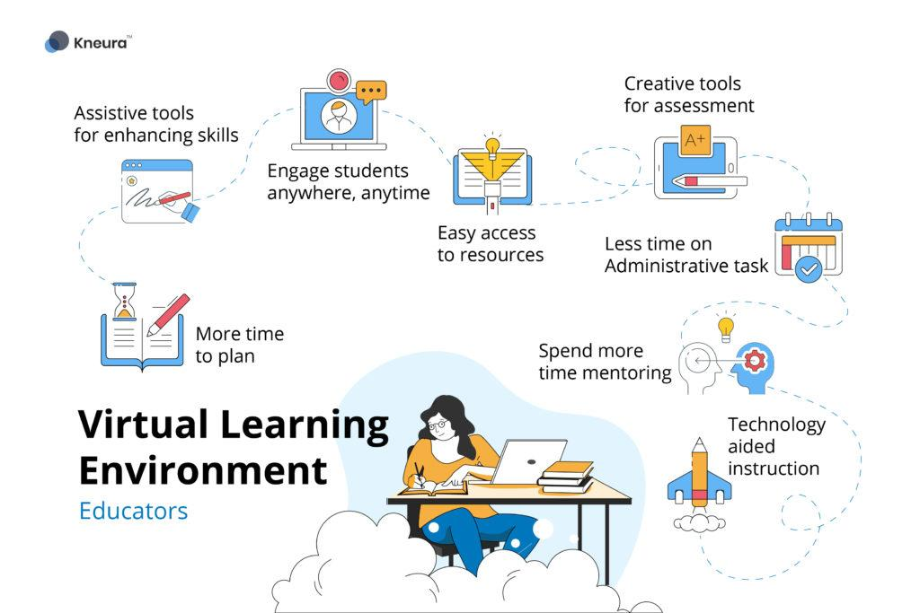

Slide 13
MAIN FEATURES
The most important and exciting feature of Edgile is the live video lecture which will be organised by the teacher.
In this feature multiple students or trainees can attend a live video lectures and raise their doubts for any query which occur in their mind.
In this, students can also watch offline recorded lecture for the future reference.
The audio feature lets students to participate in conversation during the sessions.

Slide 14


MODULES

Slide 15
REGISTRATION:- This is about creation of every type of user and every entity of system including creation of department to subjects and this also includes editing in the details of those entities and even allows to remove them as and when they become useless.
ONLINE LECTURE:-This module refers to the review of lectures and choose the appropriate videos that can help student learn from home via internet.
OFFLINE LECTURE:-Offline Lectures are the features of the system and are needed to be managed either by teacher or admin. This also empowers user with privilege to share anything they think can be useful to his/her class and will help the students for the studies.
ASSESSMENT/QUIZ:-It includes evaluations using assignment and quizzes.
Chat Room:- Here students can clear all their doubts by discussing them with teacher or fellow classmates.

Slide 16
ADVANTAGE
Removal of geographical barriers(Anywhere learning). Edgile allows learners and teachers to attend a single live training session from any place in the world, provided they have a computer and Internet connection.
Edgile has a facility to record the session so learners or teachers can replay it afterwards.
The sessions are easier to schedule or reschedule since attendees will not be traveling to the venue of the session.
One to one communication In a virtual classroom environment, learners can talk to the teacher and to each other, and although this communication is not as rich in a traditional classroom, it still can help learners, since it is one to one.

Slide 17
FACILITIES
Register new users: Instructor as an administrator has to register new users that will be attending the session.
Create a session: Instructor has to decide the session time, users that will be invited for the session. While creating a session, he can specify the time and users of the particular session.
Quiz : As an instructor, he conducts the quiz for students and evaluates on the basis of their performances .
Share Resources: Instructor can add various resources to the session. It may be a file or just a simple web page link that student can download at their end.
Q & A: Students can discuss their doubts with Instructor.

Slide 18

ACTORS OF OUR SYSTEM
The system will have 3 major roles:
Instructor/Teacher
Student
Admin

Slide 19

Instructor / Teacher
Login, Create / Modify course details, set Quizzes, assign grades
Student
Login, register / unregister for courses, take Quizzes, view lectures in offline mode
Admin
Managing user accounts, course registration approval

Slide 20
INSTRUCTOR/TEACHER
These users will be able to upload presentations, seminars, E-books and assignments which can be viewed and solved by the students.
Teachers will organise live video lectures which can be view by multiple users who are undergoing that course.
These users will also be responsible for solving the doubts raised by the students or trainees.
They can also generate tests which students/trainees will appear for.

Slide 21
STUDENT
These are those users of our system who will interact with the system to learn various courses available on this system.
These users will also be able to view live video lectures organized by the teacher and raise doubts for any query.
At the end of each course these users are expected to appear for the examination which will evaluate their performance.

Slide 22
ADMIN
The main purpose of this user will be to manage the web application as well as manage the users of this application.
They will manage the content which is being uploaded by different users.
They will also manage the database.

Slide 23

Requirements
Hardware Requirements
Processor : Dual Core or above 10
Ram : 2 GB (or) Higher
Hard disk : 20GB
Software Requirements
Web Server : Tomcat 7.0 , Xampp
Client Side Technologies: HTML, CSS, JavaScript, PHP
Server Side Technologies: PHP, Apache, MySQL, Servlets
Operating System : Microsoft Windows or any version
Database Server : MySQL

Slide 24

DATA FLOW DIAGRAM

Slide 25
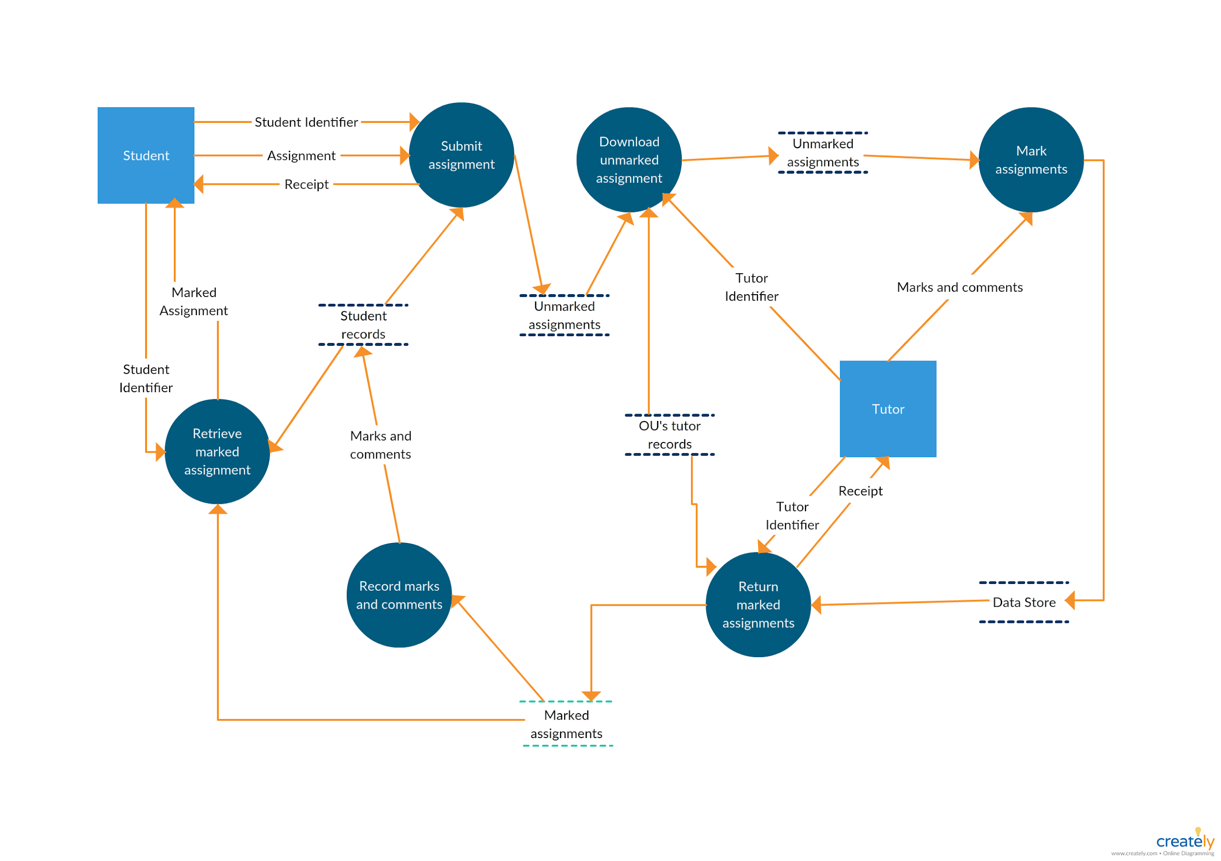

Slide 26

E-R DIAGRAM

Slide 27
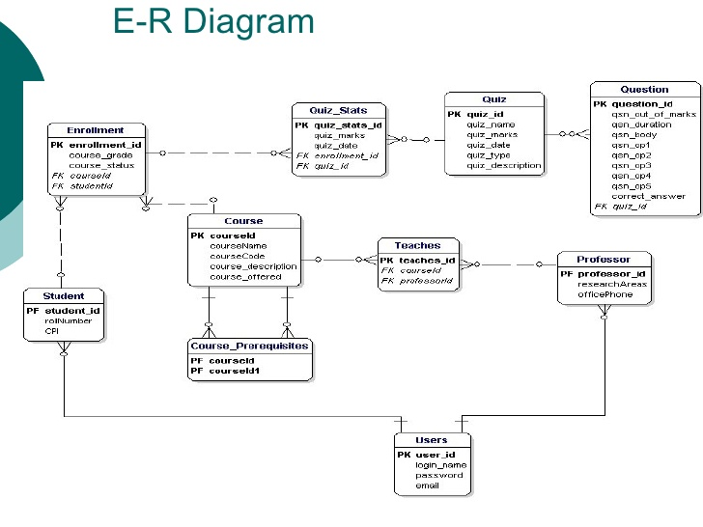

Slide 28
Here is our overview and some of the snapshots for the Edgile platform.

Slide 29
Registration
Here students can register and create their account for the further uses.
When students create their account, their details will be saved in the database. So afterwards they can use the username and password to login into Edgile.
Below is the snapshot of the registration page of Edgile.

Slide 30
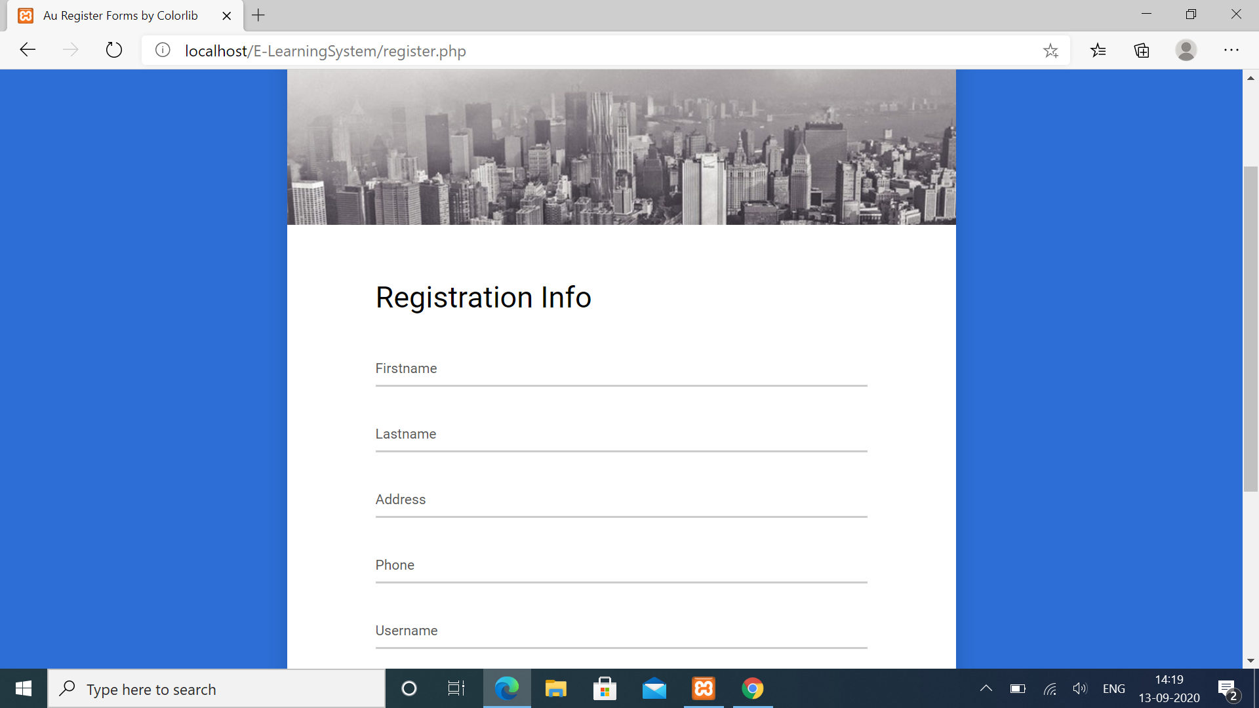

Slide 31
STUDENT LOGIN
<div class="wrap-input100 validate-input" data-validate = "Password is required">
<input class="input100" type="password" name="user_pass" placeholder="Password">
<span class="focus-input100"></span>
<span class="symbol-input100">
<i class="fa fa-lock" aria-hidden="true"></i>
</span>
</div>
<div class="container-login100-form-btn">
<button class="login100-form-btn" type="submit" name="btnLogin">
Login
</button>
</div>
Given below is snapshot of the member login page.

Slide 32
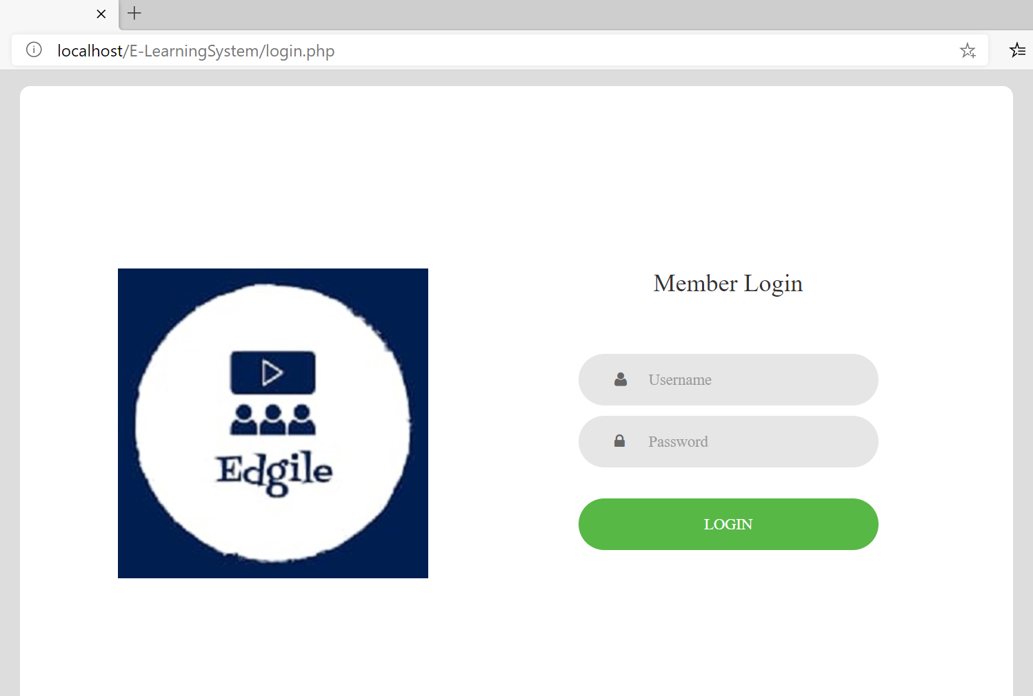

Slide 33
HOME
<div class="btn-controls">
<div class="btn-box-row row-fluid">
<a href="#" class="btn-box big span4"><i class=" icon-random"></i><b>65%</b>
<p class="text-muted">
Lesson</p>
</a><a href="#" class="btn-box big span4"><i class="icon-user"></i><b>15</b>
<p class="text-muted">
New Users</p>
</a><a href="#" class="btn-box big span4"><i class="icon-money"></i><b>15,152</b>
<p class="text-muted">
Exercises</p>
</a>
</div>
</div>
Below is the snapshot of the home page of Edgile.

Slide 34
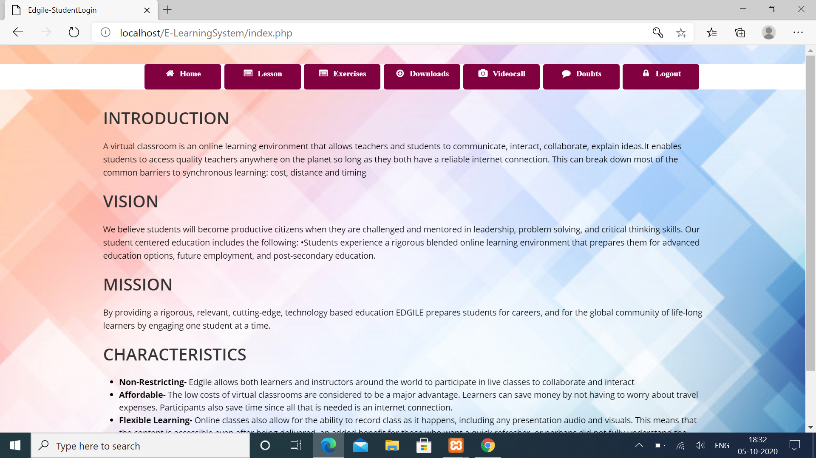

Slide 35
ADMIN
<div class="btn-controls">
<div class="btn-box-row row-fluid">
<a href="#" class="btn-box big span4"><i class=" icon-random"></i><b>65%</b>
<p class="text-muted">
Lesson</p>
</a><a href="#" class="btn-box big span4"><i class="icon-user"></i><b>15</b>
<p class="text-muted">
New Users</p>
</a><a href="#" class="btn-box big span4"><i class="icon-money"></i><b>15,152</b>
<p class="text-muted">
Exercises</p>
</a>
</div>
</div>

Slide 36
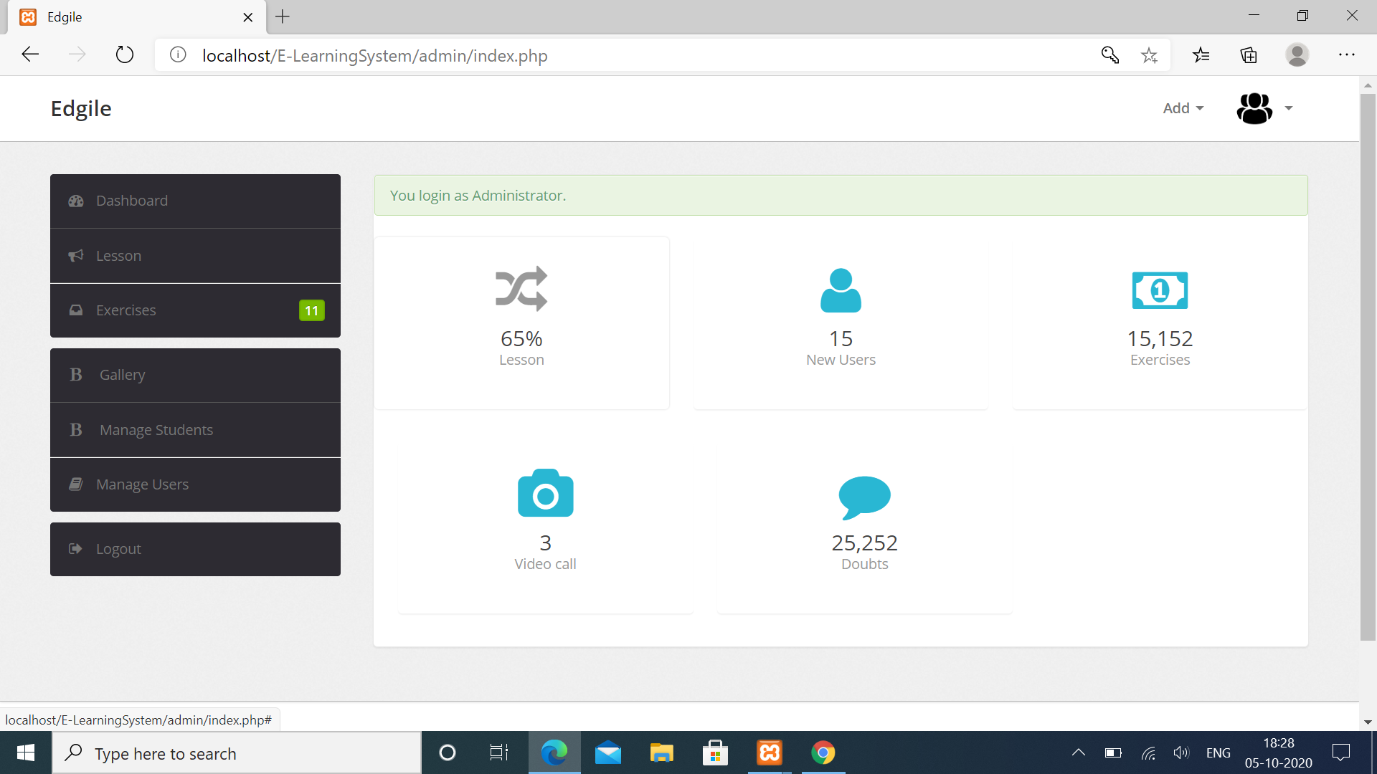
Here is the home page of Edgile Admin.

Slide 37
DOUBTS
Doubt session can be used for many purposes, such as helping students to review material prior to an assignment or quiz, engaging students in discussion of course material before coming to class, and reflecting on material that they have read or worked with outside of class.
Given below is a snapshot of the Doubt clearing platform.

Slide 38
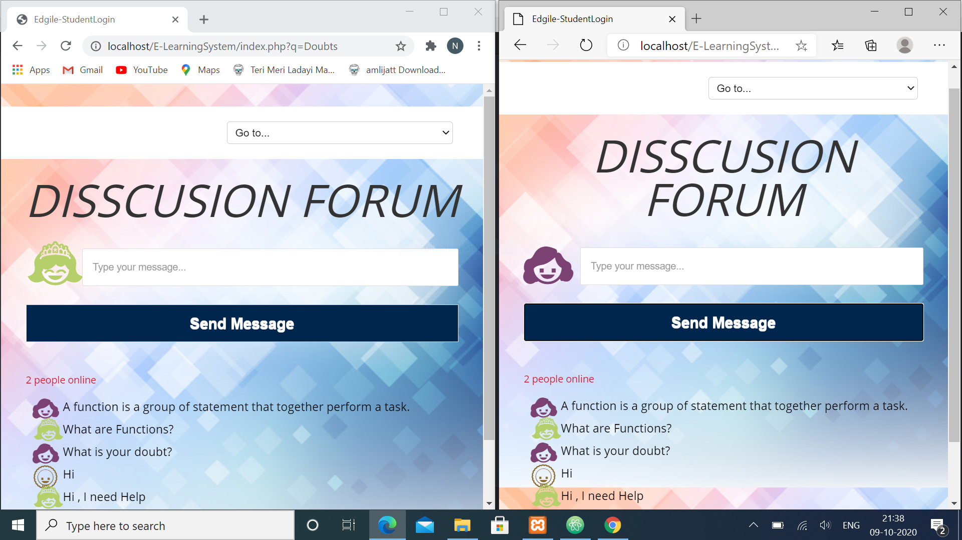

Slide 39

Video Call
Using video call feature students and teacher would get to connect easily. Video call makes the environment more lively for students and make them attentive during the ongoing classes.
Below is the snapshot of what an ongoing video conference look like where you can join the meeting.

Slide 40
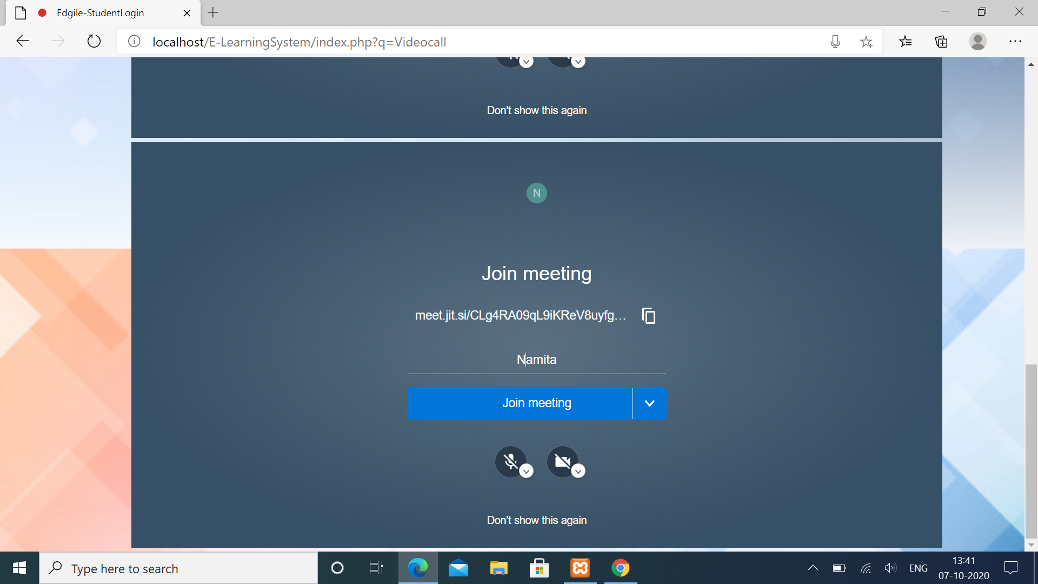

Slide 41

Our Process is Easy!
Student
EDGILE
Development

Slide 42
Link to the DEMO of our project as uploaded on youtube:
https://youtu.be/FZjEXqUT0P0
Link to the source code as uploaded on Github:
https://github.com/namita14/Edgile

Slide 43

Thanks!

